Slide 1
Field-level Validation
November 14, 2014
Notes:
Guidewire training materials contain Guidewire proprietary information that is subject to confidentiality and non-disclosure agreements. You agree to use the information in this manual solely for the purpose of training to implement Guidewire software solutions. You also agree not to disclose the information in this manual to third parties or copy this manual without prior written consent from Guidewire. Guidewire training may be given only by Guidewire employees or certified Guidewire partners under the appropriate agreement with Guidewire.

Slide 2
Distinguish between field-level validation configuration in the in the user interface and in the data model
Describe how an input mask differs from a regular expression
Identify the widget properties for UI field-level validation
Recall the steps to create an entity field validator
Identify the API methods to display user interface notifications

Slide 3
User Interface field-level validation
Data Model field-level validation
Field-level validation practices
Other User Interface notifications

Slide 4
Field-level validation
Validation is a general application behavior that prevents a user from saving invalid business data
Example:
Specifying a policy expiration date that is prior to the policy's effective date
Field-level validation is a validation behavior tied to one or more specific data fields
User interface
Configure widget properties
Data model
Specify an entity field data type
Configure entity field validators
Notes:
There are other types of validation beyond field-level validation. For example, business rules can execute validation behavior at a global level when the error may not relate to one specific field. For example, imagine that an insurance carrier allows up to 4 cars to be covered on a single personal auto policy. Then, imagine that on a given policy, an underwriter enters five cars. The business data is invalid, but there isn't any one field that is causing the error.

Slide 5
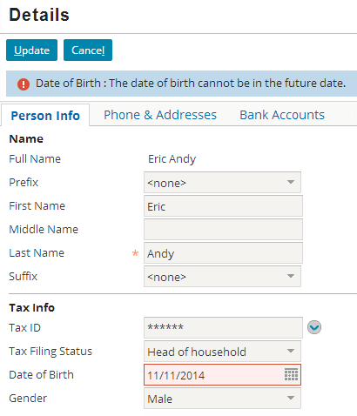
User interface (UI) field-level validation
Configure widget properties:
regex
inputMask
validationExpression
When a field requires differing validation configurations throughout the UI
When validation logic is simple
Matches a pattern
Tests a value
Notes:
Field-level validation is typically tied to the two widget types used most often to enter data: inputs and cells.
Validation error messages are displayed at the top of the screen in the same way that other errors, such as required fields with missing values, are shown.
Field-level validation checks data only when it is entered through that specific PCF file. It does not check data entered in other ways, such as through other PCF files, through Gosu code (such as business rules and enhancement methods), or through import processes.

Slide 6
Field-level validation widget properties
regex
inputMask
validationExpression
After a user navigates to a page or clicks Update, the widget property expression is evaluated
Shows value invalid field warning
Shows info bar field error
Restricts data commit
After a user navigates to a page or clicks Update, the widget property expression is evaluated
Field watermark
Placeholder causes implicit regular expression and shows field format warning
NO data commit restriction
Before commit, expression evaluated
Shows field error
Shows info bar message error
Restricts data commit

Slide 7
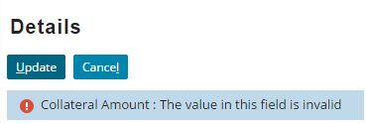

regex property behavior
As the user types, the input validated using explicit regex
Invalid field value triggers a red box warning
Mouse over the field to see the validation error message
Input validated on update and invalid value stops commit
Message bar warning displayed

Slide 8
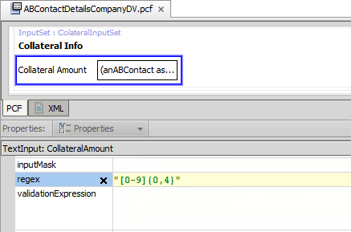
regex property
Specify a regular expression for the regex property
String literal
Display key
Gosu expression for conditional regex
Widgets supported
Text Input
Text Cell
Example:
Limits the collateral amount to a numeric value that is between 0 and 9999
Notes:
The regular expression is in the same format as that of the validator definition. This configuration also support client-side validation. If you use a Gosu expression to return conditional regular expressions, the expression evaluates when the page is (re)rendered.

Slide 9
Regular expression syntax
.+
Any non-empty string
\.
A period where the backslash (\) is an escape character
[charRange]{X}
characters in charRange, which can be any combination of 0-9, a-z, and A-Z
[charRange]{X, Y}
From X to Y characters in charRange
Most other characters are treated as literals such as a dash (-)
Notes:
The pattern for the Email validator is:
Any non-empty string, specified as: .+
An "at" symbol, specified as: @
Any non-empty string, specified as: .+
A period, specified as: \.
Any non-empty string, specified as: .+
Characters that are not treated as literals and must be escaped include: [ ] ( ) { } . * + ?
For a complete listing of syntax for validator patterns, consult the Configuration Guide for your product.

Slide 10
inputMask property behavior
Appears as a watermark in field and mouse over tooltip
Disappears with data entry; not part of the data entry
No format warning
Does not restrict data commit
1234
Notes:
An input mask does not restrict the user input for the field. An input mask identifies to the user the specific form of the data to enter into a given field. Typically, an input mask shows a basic pattern for a field. In Emerald Guidewire applications, input mask behavior differs from Diamond Guidewire applications: when the field is empty, an input mask appears in the field, but as a watermark; a mouse over tooltip shows the input mask; and when the focus is on the field and the user begins to type, the watermark disappears.
It is also possible to localize the input mask with a specify a display key for the inputMask property.

Slide 11

inputMask property placeholder behavior
Same watermark behavior, but placeholder symbol (#) cause validation using implicit regex
As the user types...
Invalid field value triggers a red box warning
Mouse over validation error message
Does not restrict data commit
####
Notes:
An input mask does not restrict the user input for the field. Rather than an input mask restricting user input, client-side regular expressions (client JavaScript and Regex) notify the user of an issue with the field input when a placeholder character (#) is used in the inputMask expression. An input mask identifies to the user the specific form of the data to enter into a given field.
When a an input mask contains placeholders (e.g., #) but does not specify either a regex property and does not have an associated entity field validator, the framework generates an implicit regular expression based on the inputMask property definition.
As user types in the field, the implicit regex triggers client-side validation. In the slide example, the field value must be 4 characters in length.

Slide 12
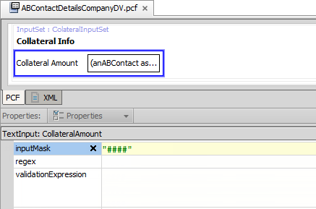
inputMask property
Specify an expression for the inputMask property
String literal
Display key
Gosu expression for conditional input masks
Widgets supported
Text Input
Text Cell
*See notes
Example:
Indicates that the field is 4 characters
Can accept any type of characters
Notes:
For certain input widgets, you can specify an expression for an inputMask property. An expression can be a string literal, a display key, or a Gosu expression. A display key has an advantage of being localized. Gosu expressions require a page (re)render but in doing so expose the potential for creating conditional input masks.
It should be noted that placeholders (#) are not a requirement for an inputMask property expression.
Text Cell, Text Area Cell, Text Input, and Text Area Input are widgets with the inputMask property. The other widgets are:
AddressAutoFillInput
BulletPointTextInput
ConfirmPasswordInput
NoteBodyInput
PasswordInput
PrivacyCell
PrivacyInput

Slide 13
validationExpression property behavior
Input validated on update and invalid value stops commit
Invalid field value shows red box warning
Mouse over the field to see the invalid value in field error message
Message bar localizable error displayed

Slide 14
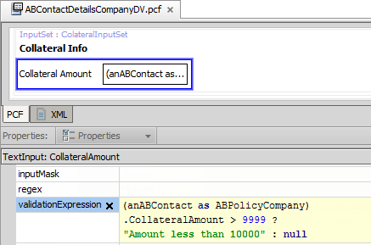
validationExpression property
Specify a conditional Gosu expression
Must return a string or null
Widgets supported
Text Input
Text Cell
Example:
Limits the collateral amount to a numeric value that is between 0 and 9999
Notes:
The regular expression is in the same format as that of the validator definition. This configuration also support client-side validation. If you use a Gosu expression to return conditional regular expressions, the expression evaluates when the page is (re)rendered.
Although not in the slide example, consider using a display key to localize the error message.

Slide 15

Validation expression
A validation expression is an expression associated with a single atomic widget that implements field-level validation
If expression returns null, save is allowed
If expression returns string (an error message), then save is prevented, field is flagged, and message is displayed at top of screen
Example:
(anABContact as ABPolicyCompany).CollateralAmount > 9999 ? "Amount less than 10000" : null
Commit OK
STOP commit
Notes:
Validation expressions are often written using a ternary expression that returns either null or a string (typically stored as a display key).
If null is returned, the data is considered valid and the save is allowed.
If errorMessage is returned:
The widget is flagged.
The string (the error message) is displayed.
The save is prevented.
Any Gosu expression that returns either null or a string (such as a call to a method) can be used.

Slide 16
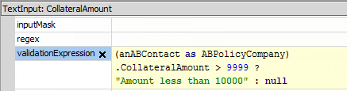
Ternary expression syntax
Often written using ternary operator ?
Syntax: condition ? null : errorMessage
or condition ? errorMessage : null
null and error message can come in either order
Notes:
Recall that a ternary expression consists of a condition and two values. If the condition is true, the expression after the ? and before the : is returned. If the condition is false, the expression after the : is returned.
Inputs and cells have two attributes that can be used for validation expressions: validationExpression and requestValidationExpression. Request validation expressions are executed during any call to the server, whether it is to commit data or to simply move to another part of the current location (such as from one card to another). This means that the condition can be evaluated before the user attempts to commit the data. However, the condition does not have access to the current value of any widget. It can check only the last saved value of widgets beyond the given widget. The requestValidationExpression is designed for the small number of cases where an invalid data value might produce extraordinary results, such as a thrown exception, before the user even commits the data. For example, a card view might have a field for a date on one card that is used to display information on some other card, and a bad date on one card will prevent the second card from rendering.
Commit validation expressions are executed when the application attempts to commit the widget's value. This means that the condition is evaluated immediately before the data is saved. However, because all widget values are being saved at this point in time, the condition can check the value of other widgets as well.
The vast majority of the time that you want to implement a validation expression, it should be using the validationExpression attribute. This is considered to be the more user-friendly approach as it doesn't evaluate the data until the user is done with his or her work.

Slide 17
User Interface field-level validation
Data Model field-level validation
Field-level validation practices
Other User Interface notifications

Slide 18
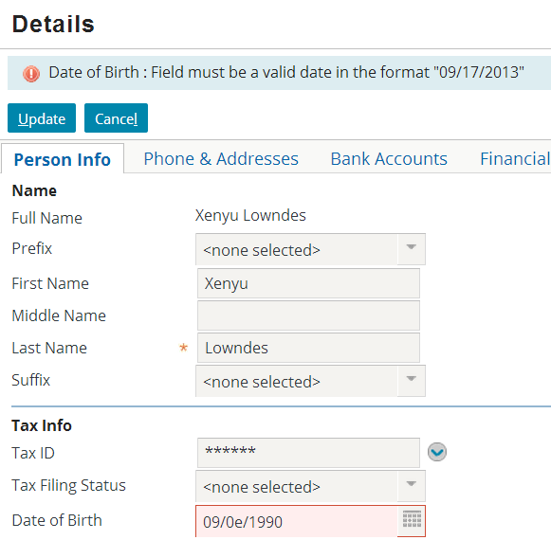
Data types
All field values in the UI are displayed and entered as strings
Data types ensure that field values are valid types that can be saved to the database
Data types are API enforced
Notes:
Guidewire application automatically prevent data of the wrong data type from being saved.
In the slide example, the user is attempting to save a date value with alphabetic characters. Every Guidewire application will automatically prevent the save, highlight the problematic field, and display an error message identifying the issue. This is inherent behavior that does not require any configuration.

Slide 19
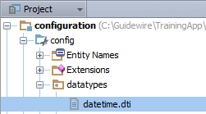
Data types files
1 <?xml version="1.0"?>
2 <DataTypeDef xmlns="http://guidewire.com/datatype" type="com.guidewire.pl.metadata. datatype2.impl.DateTimeDataTypeDef" valueType="java.util.Date">
3 <ParameterDef name="validator" desc="The name of a ValidatorDef (fieldvalidators.xml) that should be used to validate values of this data type." required="false"
type="java.lang.String"/> 4 </DataTypeDef>
Data types defined in project as .dti files
…\config\datatypes\
Example is datatime.dti
DataTypeDef specifies a implementation type and the value type
ParameterDef specifies possible parameters
Notes:
A .dti file is single data type definition. Do NOT modify a .dti file. The slide example is for illustration purposes only.

Slide 20
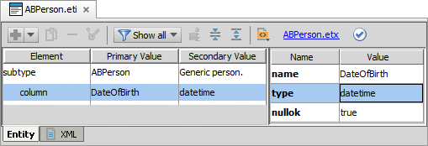
Entity element specifies data type
Data type
Entity element type attribute specifies the data type
DateOfBirth example:
Field requires a datetime data type, not varchar or boolean
Datetime.dti species that the value must be of the type java.util.Date and not java.lang.String
Can specify a columnParam that is a field validator
Notes:
Entity field-level validation requires that you define a validator column parameter in the entity or entity extension. An advantage of this approach is that you can re-use validator definitions for various entities.

Slide 21
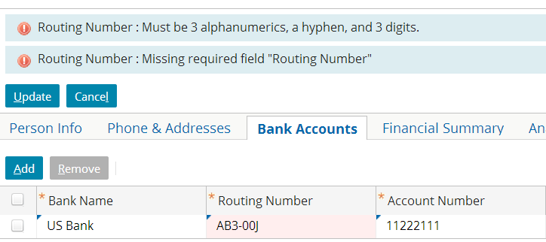
Field validators
A field validator defines the pattern for valid field values
Can be associated with one or more fields and one or more entities
If the value does not match the pattern, an error message is displayed and data is not committed
Notes:
Field validators enable you to require that a particular field match a regular expression (regex). This is a deeper level of validation than that provided by data-model validation. If a field is configured as being of “varchar” type, the values “11-1111” and “AA-AAAA” would both be valid values for that field. Field validators, however, enable you to configure the application so that a value such as “11-1111” would be rejected, even though it is valid for the configured data type.
Field validators are useful when the validation logic involves simple pattern matching and the pattern holds true every time the field is used.
Field validators are configurable. The base application comes with several field validators, but these can be modified or removed, and new ones can be added.

Slide 22
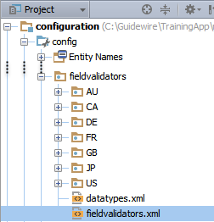
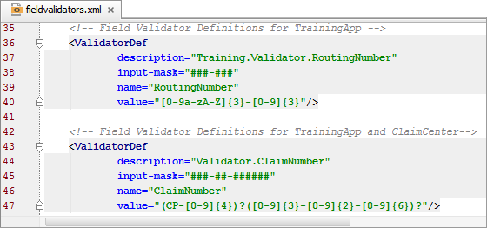
fieldvalidators.xml
…\config\ fieldvalidators\ fieldvalidators.xml
XML file defines various application field validators
Can create localized versions!
Notes:
The …\config\fieldvalidators\fieldvalidators.xml file is the default file for the application project. If you need to localize a validator, you can do so in any of the subfolders of the fieldvalidators folder. The datatypes.xml file is for base configuration data types that you can customize and in certain cases localize. For example, you may want to change the default values for precision and scale values for a default currency.

Slide 23
ValidatorDef: description
1 <ValidatorDef 2 description="Training.Validator.RoutingNumber"
3 input-mask="###-###"
4 name="RoutingNumber"
5 value="[0-9a-zA-Z]{3}-[0-9]{3}"/>
description attribute specifies the display key
Display keys must be used for description value
Do NOT include the prefix displaykey.

Slide 24
ValidatorDef: input-mask
1 <ValidatorDef 2 description="Training.Validator.RoutingNumber"
3 input-mask="###-###"
4 name="RoutingNumber"
5 value="[0-9a-zA-Z]{3}-[0-9]{3}"/>
<ValidatorDef
description="Training.Validator.RoutingNumber" input-mask="###-###"
name="RoutingNumber"
value="[0-9a-zA-Z]{3}-[0-9]{3}"/>
input-mask attribute helps user visualize formatting and is optional
Syntax for input masks:
# symbol is for any character and renders in field as "#"
All other characters are treated as literals, such as the dash –
To specify no input mask, use an empty string: ""
Notes:
An input-mask, which is optional, can assist the user in entering valid data. A Guidewire application displays the input mask to the user during editing or entering data into the field. For example, a # character indicates that the user can only enter a digit for this character. Guidewire applications interprets all other characters literally and includes them in the data.
If an input-mask has fixed characters on the end, the application displays those characters outside of the text field. For example ####mph appears as a field #### with mph on the outside end of it. For a complete listing of syntax for input masks, consult the Configuration Guide for your product.
Input masks can also be added to given widgets of type text input and text cell input through the widgets' inputMask property. This property takes a Gosu expression that returns a string to use as the input mask. If one is not specified, the input mask specified on the value's field validator will be used (if one is configured). This field should only be necessary in cases where the data type has no mask or where the mask needs to be conditional. The input mask returned should be of the same format as a mask specified using the input-mask attribute on a field validator (using # for wildcards). The input mask is recalculated on every render, which means that if the mask is conditional and dependent on other data on this page then it can change from one request to the next.

Slide 25
ValidatorDef: name
1 <ValidatorDef 2 description="Training.Validator.RoutingNumber"
3 input-mask="###-###"
4 name="RoutingNumber"
5 value="[0-9a-zA-Z]{3}-[0-9]{3}"/>
name attribute identifies validator
Use the name value to specify the validator for the field in the entity definition

Slide 26
ValidatorDef: value
1 <ValidatorDef 2 description="Training.Validator.RoutingNumber"
3 input-mask="###-###"
4 name="RoutingNumber"
5 value="[0-9a-zA-Z]{3}-[0-9]{3}"/>
value attribute is required!
Requires a regular expression (regex)
Regular expressions are a powerful way to identify and validate character patterns
Notes:
A value is a regular expression, which the field value must match in order for the data to be valid. Guidewire applications persists this value to the database, including any defined delimiters or characters other than the # character.
In the slide example, the pattern for the RoutingNumber validator is:
Any 3 alphanumeric characters, specified as: [0-9a-zA-Z]{3}
A hyphen, specified as: -
Any three digits, specified as: [0-9]{3}

Slide 27
Steps to implement field validator
Create a validator display key error message
Create a field validator
Associate the field validator with an entity element
Deploy your changes

Slide 28
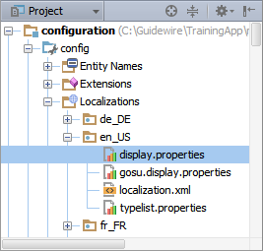
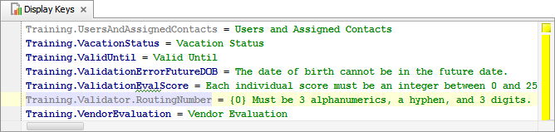
Step 1: Create validator display key error
Open display.properties for locale and create display key
Field validator error message conventions
Grouped under Validator
Begin with place-holder for widget name: {0}
Training.Validator.RoutingNumber = {0} Must be 3 alphanumerics, a hyphen, and 3 digits.
Notes:
Because the display.properties file is associated with a physical folder that reads "locale", there is often confusion between the difference between language and locale. Locale settings relate to national and cultural settings for how to display information such as numbers, currency, and dates. Language settings relate to the user selected language which localizes the application in that selected language.
Guidewire applications that are configured to support additional languages use the related display.properties file and its defined display key values. If no display key is defined for the selected language, the application uses the default language display.properties file. A setting in the config.xml file defines the default language for a Guidewire application.
You cannot create a field validator display key in Guidewire Studio when editing the fieldvalidators.xml file. Field validator display keys are referenced in XML files and are not navigable in Guidewire Studio. You can only create field validator display keys in the Display Key editor for a given display.properties file.

Slide 29
Step 2: Create field validator
Declared in fieldvalidators.xml
…\config\ fieldvalidators\ fieldvalidators.xml
validator declared in <ValidatorDef /> element
Notes:
The …\config\fieldvalidators\fieldvalidators.xml file is the default file for the application project. If you need to localize a validator, you can do so in any of the subfolders of the fieldvalidators folder.

Slide 30
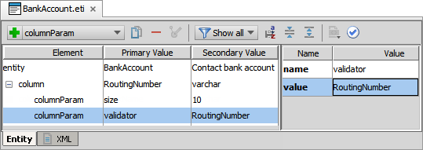


Step 3: Associate field validator with field
In Entity Editor, select field, and add a columnParam subelement
For name attribute, specify validator
For value attribute, specify the value of the name attribute in the <ValidatorDef />
Notes:
The field in question may be in an entity or entity extension. If necessary, create an entity extension for an entity located in the …\config\metadata\entity\ folder.
You use the <columnParam> element to set parameters that a column type requires. A validator is a type of column parameter.
The Entity Editor is schema aware and knows displays the available options for you when you select the type.

Slide 31
Step 4: Deploy your changes
Restart Server
Reload PCFs
Entity, Field Validator
Also PCFs and Display Keys
ALT+SHIFT+L
Internal debug tools enabled
Internal Tools
Reload → Reload PCF Files
Entity
Entity Extension
Field Validator
Page Configuration File
Display Properties
Notes:
Changes to an entity, entity extension, and/or fieldvalidator.xml file require that you start and/or restart the server. New and modified field validators are data model changes. To deploy data model changes, restart the application server. Field validators are not listed in Data Dictionary. Display keys require that you restart the server or reload PCFs.
You can restart the server using the bin command window and entering, gwXX dev-stop and the gwXX dev-start, where XX stands for the two letter application code (AB, CC, PC). Or, from Guidewire Studio, stop the 'Server' process with Run → Stop ,and then start the process again with either Run 'Server' or Debug 'Server'.
In Studio, the newly created or modified entity is available to reference immediately. However, the entity is not available to the application server until the server is restarted and the database upgraded. The automatic database upgrade process occurs only if the database autoupgrade=true attribute is defined in the database-config.xml.
It is also possible to reload PCF files using the Guidewire API and/or internal server tools. The Reload PCF command can be found on the Reload page in Internal Tools. To access Internal Tools, the EnableInternalDebugTools setting in the config.xml file must be set to true. The keystroke to open the Internal Tools page is ALT+SHIFT+T. In the tab bar, select Internal Tools --> Reload. On the Reload page, click the Reload PCF Files button. Both the keystroke ALT+SHIFT+L and the Reload PCF Files button call the same static method: gw.api.tools.InternalToolsUtil.reloadPCFs().

Slide 32
User Interface field-level validation
Data Model field-level validation
Field-level validation practices
Other User Interface notifications

Slide 33
Input mask configuration comparison
Entity field validator:
User interface (UI) widget:
Create a display key for a custom error
In fieldvalidators.xml, create a <ValidatorDef />
Specify a description attribute using a display key
Specify a input-mask attribute using a placeholder or string
Define a validator column parameter for the entity field
Automatically applied throughout the UI
inputMask property
Text Input
Text Cell Input
Specify an inputMask value
String literal or display key with or without placeholder
Gosu expression for conditional input mask
Must configure for each widget individually
Notes:
Configurators often define input masks with entity field validators in the fieldvalidators.xml file. In the fieldvalidators.xml file, configurators specify the value of the input-mask attribute within a <ValidatorDef /> element. An advantage of this approach is that you can localize the fieldvalidators.xml file per locale.
Text input and cell input widgets also support an inputMask property. This property takes a string expression. You can use a Gosu expression that returns a string as the input mask. This is typically how configurators specify a conditional input mask. However, an input mask of this type necessitates that the server evaluate the Gosu expression on every page (re)render. For a localized input mask, consider using a display key.

Slide 34
Regex configuration comparison
Entity field validator:
User interface (UI) widget:
Create a display key for a custom error
In fieldvalidators.xml, create a <ValidatorDef />
Specify a description attribute using a display key
Specify a value attribute using regular expression for pattern matching
Define a validator column parameter for the entity field
Automatically applied throughout the UI
regex property
Text Input
Text Cell Input
Specify a regex value
String literal or display key
Gosu expression for conditional regex
Must configure for each widget individually
Notes:
You can configure regex validation on an regex property of supported input widget or in the entity field validator definition.
Configurators often define validation expression with entity field validators in the fieldvalidators.xml file. In the fieldvalidators.xml file, configurators specify the value of the value attribute within a <ValidatorDef /> element. An advantage of this approach is that you can localize the fieldvalidators.xml file per locale.
Text input and cell input widgets also support a regex property. This property takes a string expression. You can use a Gosu expression that returns a string as the regular expression. This is typically how configurators specify a conditional expression for field-level validation. The application evaluates the Gosu expression in every page (re)render.

Slide 35
Practices comparison
Entity field validator:
User interface (UI) widget:
Application enforces data model compliance in the UI and through the API
Supports full localization
Static values only
Robust extensibility
Only a few widgets support
Commit
inputMask does NOT stop commit
regex stops commit
validationExpression occurs before commit
Custom error message
inputMask and regex have NO custom error message option
validationExpression allows for custom error message
Dynamic values
inputMask and regex values can be a display key or Gosu expression
Extensibility a big concern

Slide 36
Practices for field-level validation
Always specify a regular expression for validation for pattern matching
Specify a descriptive input mask without placeholders
If a regex is not defined, a placeholder input mask automatically generates an implicit regular expression
User interface validation is applicable to a few widgets and a few properties, but can be dynamic
Avoid server-side processing for complex user input validation
Gosu expressions for validation require server-side processing
Consider rule based validation
Entity field-level validation is most robust, but static

Slide 37
User Interface field-level validation
Data Model field-level validation
Field-level validation practices
Other User Interface notifications

Slide 38
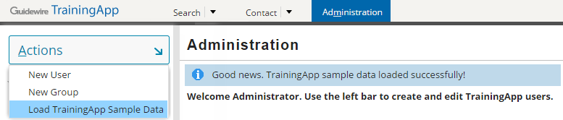
Other UI notifications (1)
gw.api.util.LocationUtil contains static methods
addRequestScopeInfo(String) to show information message
addRequestScopeWarning(String) to show warning message
addRequestScopeError(String) to show error message
Use display keys for message strings
Shows message at top of page
Notes:
1 package trainingapp.base
2 uses gw.api.util.DisplayableException
3 uses gw.api.database.Query
4 uses gw.transaction.Transaction
5 uses gw.api.util.LocationUtil 6 uses trainingapp.demo.gosu.MiscellaneousExamples
7 class SampleDataUtil {
8
9 static function loadTrainingAppSampleData () : void {
10 try {
11 // load sample data
12 new gw.command.ImportSampleData().import()
… // delete orphan messages in sample data
15 SampleDataUtil.deleteOrphanMessages()
16 trainingapp.demo.gosu.MiscellaneousExamples.waitForXSeconds(20, false)
17 LocationUtil.addRequestScopedInfoMessage(displaykey.Training.
TrainingAppSampleDataLoaded) 18 } catch (e : java.lang.Exception) {
19 throw new DisplayableException(displaykey.Training. TrainingAppSampleDataNOTLoaded)
20 }
21 }
…

Slide 39
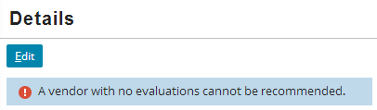
Other UI notifications (2)
1 uses gw.api.util.DisplayableException
2
…10 static function toggleVendorRecommendedFlag() () : void { …24 if (thisVendor.VendorEvaluations.length == 0) {
25 throw new DisplayableException(displaykey.Training.NoEvaluations)
…27 }
…44 }
gw.api.util.DisplayableException
Shows notification at top of page
Requires the throw new keywords
Notes:
The DisplayableException() method is an constructor with multiple signatures:
DisplayableException(String[] messages)
DisplayableException(String message, Throwable cause)
DisplayableException(DisplayKey message)
DisplayableException(DisplayKey message, Object[] msgArgs)
DisplayableException(DisplayKey message, Throwable cause)
DisplayableException(DisplayKey message, Object[] msgArgs, Throwable cause

Slide 40
Distinguish between field-level validation configuration in the in the user interface and in the data model
Describe how an input mask differs from a regular expression
Identify the widget properties for UI field-level validation
Recall the steps to create an entity field validator
Identify the API methods to display user interface notifications

Slide 41
What are the two types of field-level validation at the data model level? Can both of them be configured?
What happens if a widget's validation expression returns null?
Assume that there is an Order entity that has an OrderNumber field. The field appears on two detail views: LegacyOrdersDV and NewOrdersDV.
Name a situation where you would implement validation logic for the OrderNumber field at the data model level.
Name a situation where you would implement validation logic for the OrderNumber field at the UI level.
Name a static method that displays a user notification.
Notes:
Answers
1. data type validation (which cannot be configured) and field validators (which can be configured).
2. The save is allowed—a return value of null signifies that the validation condition was met.
3a. Possible answer: The OrderNumber field has a pattern, such as two characters, a hyphen, and five characters, and this pattern must be followed everywhere the field is used. Also, you want to localize the error message.
3b. Possible answer: On the detail view for orders imported from a legacy system, the order number could take any format. On the detail view for orders created in the Guidewire application, the order number must start with the characters "GW-“.
4. gw.api.util.LocationUtil contains several static methods for displaying a user notification: addRequestScopeInfo(), addRequestScopeWarning(), addRequestScopeError() .

